Slide 1


Live Event resources
Pre- event checklist
Planning template
Messaging templates
Schedule templates
PowerPoint 1-pager
Post-event checklist
Post-event summary/reporting template

Slide 2

Pre-event checklist
What is your business outcome?
Where will you host the live event? In an existing Yammer group or a new one?
Who is your intended audience?
How do you plan to promote it? On Yammer? Email? Newsletter?
Will you need technical assistance or a production team?
Best Practice: Practice with speakers prior to the live event to feel confident about the technical and production before hosting your first event.

Slide 3
Planning template
Task | Breakdown | Status
Business opportunity | Who is the event sponsor? Event justification—one or two sentences In what way will the sponsor benefit?
Audience | Who is the primary audience? How does the audience benefit from participation? Is this audience already located within a Yammer group or do we need to create a new one?
Gather Event Team | Sponsor—which group or team will sponsor the live event? Event Organizer—who is the person responsible for communication and logistics. Presenters—who are the subject matter experts that will lead the content and presentations, and be available to answer questions? Yammer Moderators—who is the person who will ask questions and ensure the questions get answered?
Content | Main messages (related to the business opportunity) Questions and owners (experts)
Technical | What kind of live event are you hosting? Will you use a production team? What types of devices will be used for your event? When is the practice for the presenters to feel confident with the technology?
Promotion | Communications channels (email, Yammer groups, meetings, etc.) What resources will you use?
Measurement and feedback | What does success look like? Do you have any expectations? How will you measure engagement? How will you capture both qualitative and quantitative feedback? Do you have a metrics-based baseline to measure against?
Next steps | What happens next? When’s the next event? Key dates and high-level schedule
This template is a suggestion to help you plan and prepare. Customize based on the tasks that match your organizational needs.

Slide 4
[SAMPLE] Communication Templates
We recommended that messages be sent from the organizer to give continuity to the communications. We've included a few sample communication messages for you to edit and use. You can send via email or post to social platforms.
You’re invited
Subject: Save the date – [Topic] Live Event
You are invited to join us for a live event in Yammer where we will discuss [topic].
Date: Time: Group: [Link URL]
If this is your first live event in Yammer, it is a hosted live and we curate questions in Yammer prior and as the event that takes place. If you have a question [FOR THIS LEADER/TOPIC] post in our Yammer Group. [link to Yammer group]
Add to my calendar [Attendee link]
Hopefully, you can join us.
[Signed by organizer]
Reminder - tomorrow
Subject: [Topic] Live Event in Yammer is happening tomorrow
Hi [name],
Tomorrow is our [topic] live event in Yammer.
Here is a taste of what we’ll be talking about:
[Sub topic]
[Sub-topic]
[Sub-topic]
Don't forget to post your questions in our Yammer group to be answered live.
[Signed by organizer]
Date: Time: Group: [Link URL]
Add to my calendar [Link to attendee link]
NOTE:
Not all messages need to be used – it's up to you when you communicate
Customize these templates.

Slide 5
[SAMPLE] Follow up message to attendees
Subject: Thank you for joining us for [LIVE EVENT NAME]
Hi [name],
Thanks so much for joining our [LIVE EVENT NAME]. I'm glad you could join us and hope you learned some useful tips and strategies that will help you in your job.
One of the great things about using Yammer with these events is that the conversation continues after the event has finished. You're invited to continue to learn and contribute to the group at the link below. You will also find a link to recording in the Yammer group if you want to reference any of the presentation.
[link to Yammer group]
If you have any questions, please let me know.
[Signed by organizer]
Best Practice: Share conversations or highlights from the event. Showcase analytics from the event by looking at Group Insights.

Slide 6
[SAMPLE] Live Event Schedule
This is a suggested outline and timing of some of the key items and areas you may want to track when planning a live event in Yammer. Use this template to track your progress by adding actual dates and times and customizing items for your organization .
Pre-event
Determine business need and related goals/outcomes | At least 2 weeks before | Sponsor/Event Organizer
Determine related content | 1-2 weeks before | Sponsor/Event Organizer
Define KPIs | 1-2 weeks before | Sponsor/Event Organizer
Assign roles and expectations | 1-2 weeks before | Event Organizer
Notify and train presenters | 5 Days before | Event Organizer
Determine event schedule content/posts | 3 Days before | Event Organizer
Set up meeting with event team, presenters, speakers to practice and review flow | 2 Days before | Event Team: Event Organizer, Presenters, Producers, Yammer Moderators
Load initial content | 1 Days before | Event Organizer
Live Event in Yammer
Set up meeting with experts and host – review questions and flow | 30 minutes before | Event Team: Event Organizer, Presenters, Producers, Yammer Moderators
Post welcome message and introduction question | 5 minutes before | Yammer Moderators
Facilitate Questions to Presenters | During | Yammer Moderators
Close up – Thank everyone and encourage continued conversation | 55 minutes after | Event Organizer
Request feedback from presenters | 1 day after | Event Organizer
Post thank you for attending messages | Hours after | Yammer Moderators
Schedule continued on the following page

Slide 7
[SAMPLE] Live Event Schedule
Post-event
Share follow up conversations or open questions with presenters | Hours after | Event Organizer, Yammer Moderators
Prepare analysis, download Engagement Report and compare against KPIs | Day after | Event Organizer
Review group conversations and share recordings and content. | Days after | Event Organizer
Present findings to sponsor and debrief event | Week after | Event Team: Event Organizer, Presenters, Producers, Yammer Moderators
Customize the schedule to fit your audience and content.

Slide 8


1-pager PPT invite
[Topic] Event
You’re invited
Hosted by [Leadership Member]
[Date]
[Time]
[Name] Yammer Group
1-pager PPT slide
What is a Live Event in Yammer?
A Live Event in Yammer is a meeting or town hall hosted virtually with discussion within your Yammer group.
Leader or expert ”ask me anything”, Trainings or department all-hands
The conversation continues in Yammer after the event concludes
More inclusive with global reach with recordings available with closed captioning and searchable transcripts.
Easy to set up and manage
Scalable, focused, low cost and measurable

Slide 9

You’re invited
[Topic]
Live Event
Hosted by [Leadership Member]
[Date]
[Time]
[Name] Yammer Group

Slide 10

Post Event Checklist
Have a plan on what you will communicate, including access to the recording and shared content.
Remind the speakers follow up on open conversations or unanswered questions in Yammer.
Send out follow up and thank you communications—email and Yammer posts.
Review Yammer usage and engagement data from the Group Insights tool.
Start planning your next live event and adjust and adapt based on what you’ve learned.
Best Practice: Showcase great conversations to use for promotional materials for your next event.

Slide 11
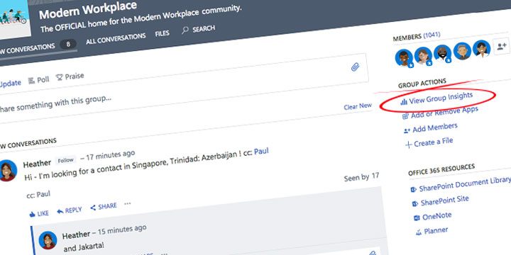
Event Report template
Data can be collected by clicking on the Group Insights link on the right side of the Yammer group page.
Event sponsor: [Leader, group, team, or organization]
Event background: [Add a brief sentence or two about why you hosted the event.]
People | Organize: Presenters: Yammer Moderators | [Key Takeaway]
Audience | Potential audience size Number of attendees (active and non-member) | [Key Takeaway]
Questions | Number of questions Number of comments per question | [Key Takeaway]
Engagement | Likes Shares Total comments | [Key Takeaway]
Anecdotal highlights and quotes | “quote” [highlight] | [Key Takeaway]

Slide 12
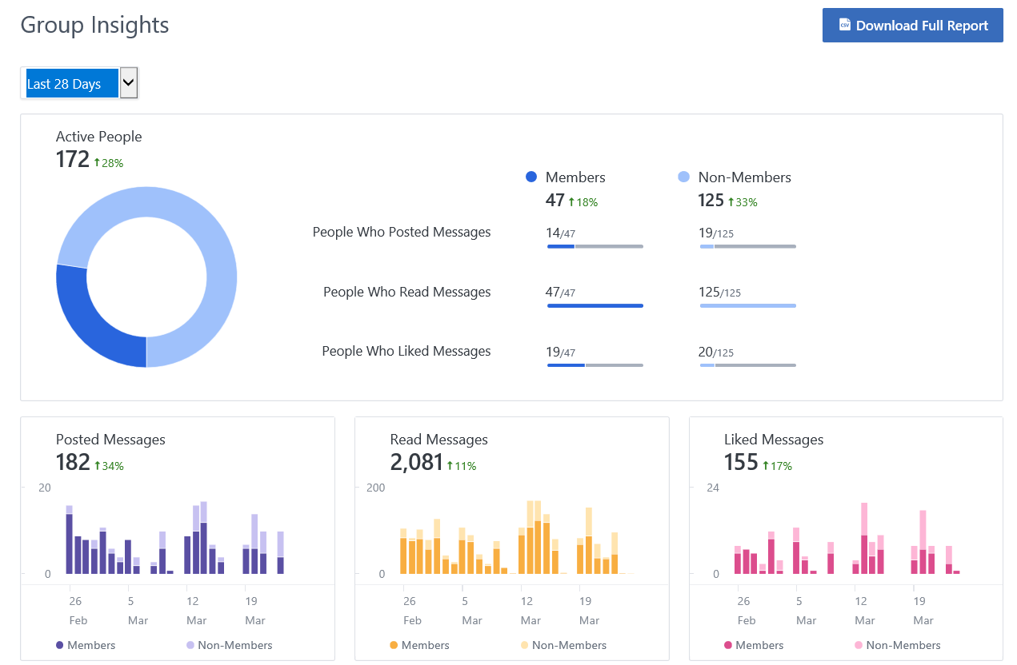
Group Insights data
Best Practice:
Reporting shows the last 12 months, 28 days and 7 days. Take a screenshot before your event so you can see what impact your event had.
Access Group Insights on the right column in your Yammer group in the Group Actions section.
From here, see statistics and trends over time such as:
Active people (members and non-members)
Posted, read, and liked messages
Total numbers related to each data point
You can also download the full report which will give you an Excel file with more data points and the ability to set your own date parameters.

Slide 13

Yammer

